Slide 1
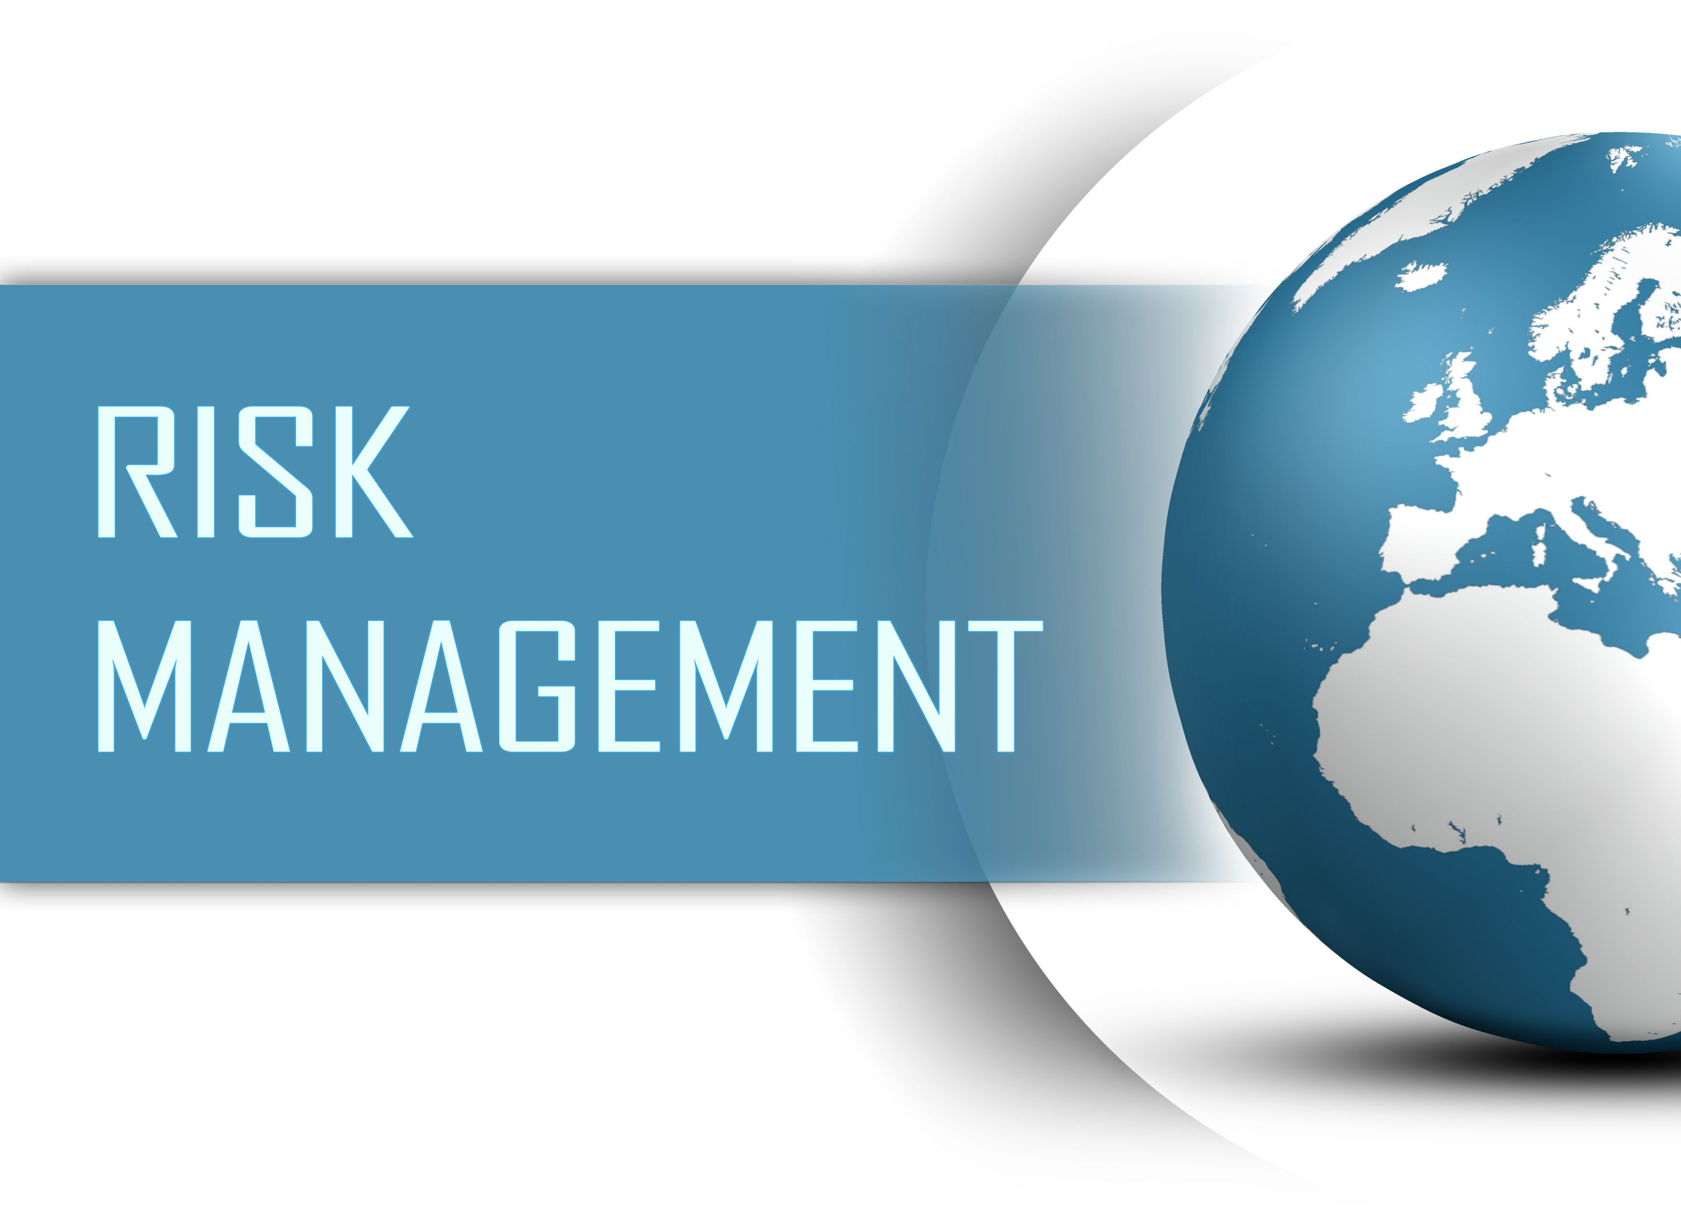

By Soha Sarwar– June 22, 2020
Software Engineering Standards-
1)P16085/CD3, August 2019 - ISO/IEC/IEEE International Draft Standard - Systems and Software Engineering - Life Cycle Processes - Risk Management

Slide 2

CONTENTS
Risk Management
Risk Lifecycle
Types of Activities
Key Points
Importance
Summary
1)P16085/CD3, August 2019 - ISO/IEC/IEEE International Draft Standard - Systems and Software Engineering - Life Cycle Processes - Risk Management

Slide 3


Risk Management
Life Cycle Process
Risk is an inexorable and an unavoidable part of a software development process, which constantly evolves throughout the course of a project, affecting a project or software or both. Thus, it arise the necessity to deal and manage these risks in an efficient and effective manner.
In the field of software engineering, risk management is a methodology or a mechanism, carried out throughout the development process to identify, manage and control risks evolved before and during the development process. Basically, three types of activities are covered under the risk management process.
“This standard describes a process for the management of risk during systems or software acquisition, supply, development, operations, and maintenance.”

Slide 4
Risk Lifecycle
Risk Management -
Identification
You can’t manage your risks if you don’t know what they are, or if they even exist. The first step is to identify the events that influence your ability to achieve your objectives, define them and assign ownership.
Assessment
Once the risks have been identified they need to be examined in terms of likelihood and impact. It is important to assess the probability of a risk, and the consequences of this risk occurring.
Treatment
Once the risk has been assessed, an approach for treating each risk should be defined. After evaluation, some risks may not require any actions but just need to be monitored.
Monitoring
Once the risk is identified, assessed and a treatment process defined, the risk cannot be left. Things can always change so the review process is essential for managing risk proactively.
Reporting
Reporting at each of the four stages above is a core part of driving decision making ineffective risk management.

Slide 5
Types of activities
Risk Analysis
Risk analysis involves examining how project outcomes and objectives might change due to the impact of the risk event. Once the risks are identified, they are analyzed to identify the qualitative and quantitative impact of the risk on the project so that appropriate steps can be taken to mitigate them.
Risk Identification
Risk identification is the process of determining which risks may affect the project and documenting their characteristics. The key benefit of this process is documentation of existing risks and the knowledge and skills offered by the project team anticipate risk events..
Risk Identification
Risk Analysis
Risk Control
Risk Control
Risk Control is a process that involves the implementation of risk response plans. It also involves tracking the identified threatening risks, identifying new risks, monitoring residual risks as well as evaluating the efficacy of risk processes utilized during the entire project.

Slide 6
Key Points
Identification
Risk management involves identifying and assessing project risks to establish the probability that they will occur and the consequences for the project if that risk does arise..
Identification
Task Recognition
Risk management is now recognized as one of the most important project management tasks.
.
Task Recognition
Distinct
Software management is distinct from other engineering management. Software is intangible. Projects may be novel or innovative with no body of experience to guide their management.
Distinct
Development
Development
Good project management is essential if software engineering projects are to be developed on schedule and within budget.

Slide 7
Why is it Important?
Affects
Risk affects all aspects of your project – your budget, your schedule, your scope, the agreed level of quality, and so on
%
Positive Event
Increase probability of positive event.
%
Negative Event
Reduce the occurrence of negative event.
%

Slide 8

Summary
The benefit of risk management in projects is huge because the outcome of project failure is wasted dollars that steal investor profits and have a negative impact on the organization’s bottom-line. Risk assessments allow you to deal with uncertain project events in a proactive manner. This allows you to deliver your project on time, on budget and with quality results.
Complete your risk assessment early on in the project’s execution and continuously (i.e.; every to 3 months), throughout the project’s lifecycle. It will increase your project’s success likelihood. And, whenever possible, measure the effects of your risk management efforts and continuously implement improvements to make it even better.

Slide 9
Software Engineering Standards-
Life cycle management -software development planning
2) 24748-5-2017- ISO/IEC/IEEE International Standard-Systems and Software Engineering—life cycle management --Part 5: software development planning

Slide 10
CONTENTS
Software Development Planning
Steps to Software development plan
Roles & Responsibilities
Meeting & Scope
Planning Steps
Communication
Summary
24748-5-2017- ISO/IEC/IEEE International Standard-Systems and Software Engineering—life cycle management --Part 5: software development planning
.

Slide 11
Software Development Planning
This standard focuses on the processes required for successful planning and management of the project's software development effort and for development of the software development plan (SDP) as a vehicle for representing a project's application of software life cycle processes. The SDP is a top level technical planning document for a project which addresses technical management processes established by three principal sources as necessary to successfully accomplish the software development related tasks of the project.
The purpose of the Software Development Plan is to gather all information necessary to control the project. It describes the approach to the development of the software and is the top-level plan generated and used by managers to direct the development effort.
It provides a common framework for planning and controlling the technical processes and activities to produce and sustain software products, from idea conception to the retirement of a software product. The framework described by this document provides for best practices in communication and cooperation among parties that plan for, develop, utilize, and manage modern software

Slide 12

10 Steps to Software Development Plan
4
Step4:
Hold a kickoff meeting.
One of the critical factors for project success is having a well-developed project plan, showing how it provides a roadmap for project managers to follow
5
Step5:
Develop scope baseline
Step1:
Explain the project plan to key stakeholders and discuss its key components
6
Step6:
Develop the schedule and cost baselines
1
2
Step2:
.Define roles and responsibilities
7
Step7:
Develop the staffing plan.
3
Step3:
Develop a Scope Statement.
8
Step8:
Create baseline management plans
9
Step9:
Analyze project quality and risks..
10
Step10:
Communicate.

Slide 13
Roles and Responsibilities
Project Sponsor
Project Manager
Team
End Users
who owns and funds the entire project. Sponsors need to review and approve all aspects of the plan.
.
01
who creates, executes, and controls the project plan. Since project managers build the plan, they do not need to approve it.
02
who build the end product. The team needs to participate in the development of many aspects of the plan, such as identifying risks, quality, and design issues, but the team does not usually approve it.
03
who use the end product. They too, need to participate in the development of the plan, and review the plan, but rarely do they actually need to sign off.
04

Slide 14
Meeting and Scope Statement
Kickoff Meeting
Scope Statement
The kickoff meeting is an effective way to bring stakeholders together to discuss the project. It is an effective way to initiate the planning process. It can be used to start building trust among the team members and ensure that everyone's idea are taken into account. Kickoff meetings also demonstrate commitment from the sponsor for the project. Here are some of the topics that might be included in a kickoff meeting:
.
The Scope Statement is arguably the most important document in the project plan. It's the foundation for the rest of the project. It describes the project and is used to get common agreement among the stakeholders about the scope. The Scope Statement clearly describes what the outcome of the project will be..
Business vision and strategy (from sponsor)
Project vision (from sponsor
Team commitments
How team makes decisions
Ground rules
Roles and responsibilities
Business Need And Business Problem
Project Objectives
Benefits Of Completing The Project
Project Justification
Project Scope
Key Milestones

Slide 15

Planning Steps(Continue..)
Scope Baseline, Schedule & Cost, baseline management plans, staffing plan, quality and risks
Scope Baseline
Staffing Plan
Baseline Management
Schedule and Cost
Quality & Risk
Once the deliverables are confirmed in the Scope Statement, they need to be developed into a work breakdown structure (WBS), which is a decomposition of all the deliverables in the project.
The staffing plan is a chart that shows the time periods, usually month, quarter, year, that each resource will come onto and leave the project.
Once the scope, schedule, and cost baselines have been established, you can create the steps the team will take to manage variances to these plans.
Identify activities and tasks needed to produce each of the work packages, creating a WBS of tasks.
Project quality consists of ensuring that the end product meets the customer requirement.

Slide 16
Communicate
Who on the project wants which reports, how often, in what format, and using what media?
How issues will be escalated and when.
Where project information will be stored and who can access it
This communication should include such things as:
Review and approval of the project plan.
Process for changing the contents of the plan.
Next steps—executing and controlling the project plan and key stakeholder roles/responsibilities upcoming phases.
For complex projects, a formal communications matrix is a tool that can help determine some of the above criteria
It helps document the project team's agreed-on method for communicating various aspects of the project, such as routine status, problem resolution, decisions, etc.
Once the project plan is complete, it is important not just to communicate the importance of the project plan to the sponsor, but also to communicate its contents once it's created.

Slide 17
Summary
Need of Software Planning: Project planning software makes it easier to create the work breakdown structure, estimate the work effort required for each task from the WBS, establish the most logical activities sequence during the project scheduling phase and easily define and identify those risks which may impact the progress of the project. The purpose of the Software Development Plan is to gather all information necessary to control the project. It describes the approach to the development of the software and is the top-level plan generated and used by managers to direct the development effort.

Slide 18
THANK YOU
.

